Slide 1
UNHCR Global Trends 2021
Summary of key trends
www.unhcr.org/globaltrends
Notes:
45 minutes

Slide 2
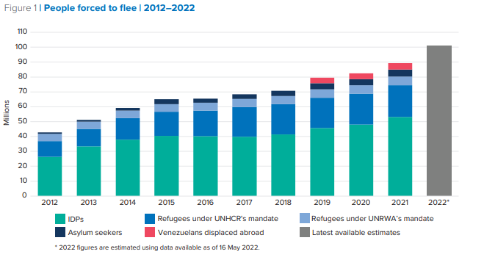
89.3 million forcibly displaced worldwide at the end of 2021 – increasing to more than 100 million by May 2022
27.1 million refugees (+754,400), including 5.8 million Palestinian refugees under UNRWA’s mandate.
53.2 million IDPs¹ (+5.1 million).
4.6 million asylum seekers (+438,400).
4.4 million Venezuelans displaced abroad (VDA) (+544,300).
Source: 2021 Global Trends, © UNHCR
¹ Internal Displacement Monitoring Centre
Notes:
Overview graph with FD population group increases

Slide 3
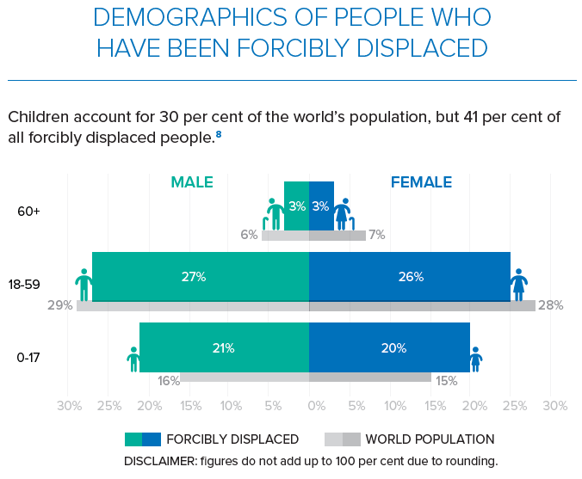
Demographic coverage continues to improve for forcibly displaced people and for other population groups
Population Group | Female | Children
Refugees | 49% | 49%
People refugee-like situations | 41% | 52%
Palestine refugees under UNRWA’s | 49% | 31%
Venezuelans displaced abroad | 51% | 28%
Asylum-seekers | 40% | 25%
Internally displaced people¹ | 50% | 43%
Refugee returnees | 54% | 58%
IDP returnees | 50% | 58%
Stateless Persons | 52% | 44%
Others of concern | 54% | 28%
Source: 2021 Global Trends, © UNHCR
¹ Internal Displacement Monitoring Centre

Slide 4
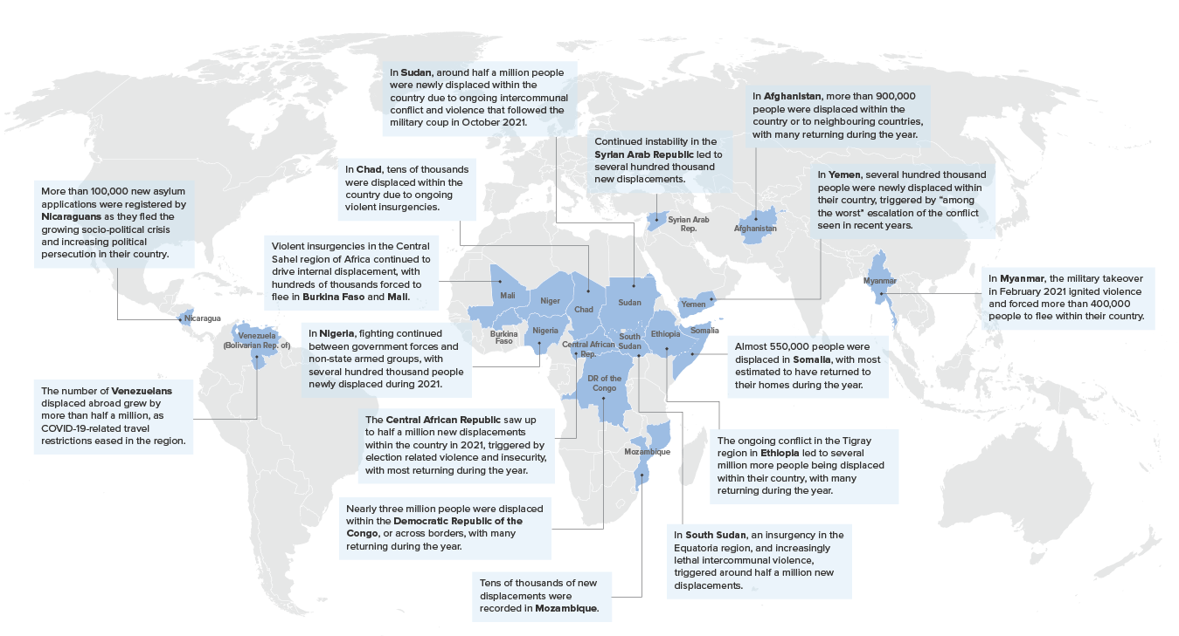
Forced displacement could become one of defining the legacies of the 21st century
Conflicts around the world are substantially increasing in both numbers and magnitude.
A total of 23 countries with a population of 850 million people, faced high- or medium-intensity conflicts in 2021.
2022 has already seen millions displaced by the war in Ukraine, while the humanitarian crises in Myanmar and Burkina Faso and elsewhere continued to deteriorate.
Source: 2021 Global Trends, © UNHCR

Slide 5
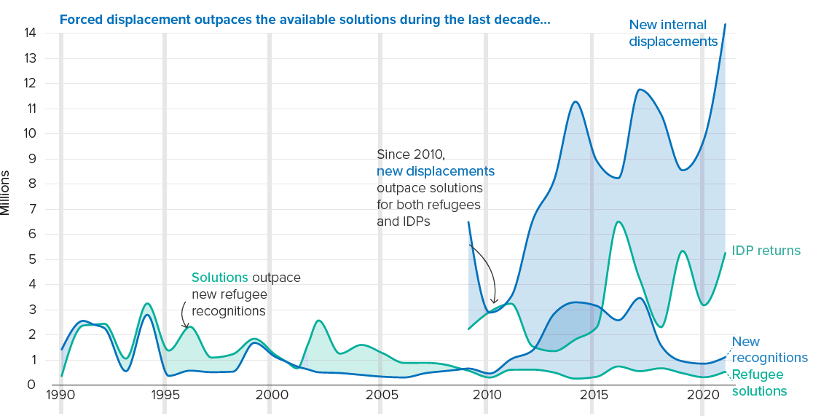
The availability of durable solutions is not keeping track with forced displacement
The global forced displaced population has more than doubled since 2012, while the available solutions have not kept pace.
Durable solutions have therefore become an option for fewer and fewer refugees and internally displaced people.
Greater international solidarity and responsibility-sharing are urgently required
to work together to resolve existing conflicts;
to help address root causes to mitigate the risk of future conflicts unfolding in increasingly fragile states; and
to deliver sustainable opportunities at the scale required to allow forcibly displaced people to live in safety and with dignity.
Source: 2021 Global Trends, © UNHCR

Slide 6
Refugees and Venezuelans displaced abroad

Slide 7
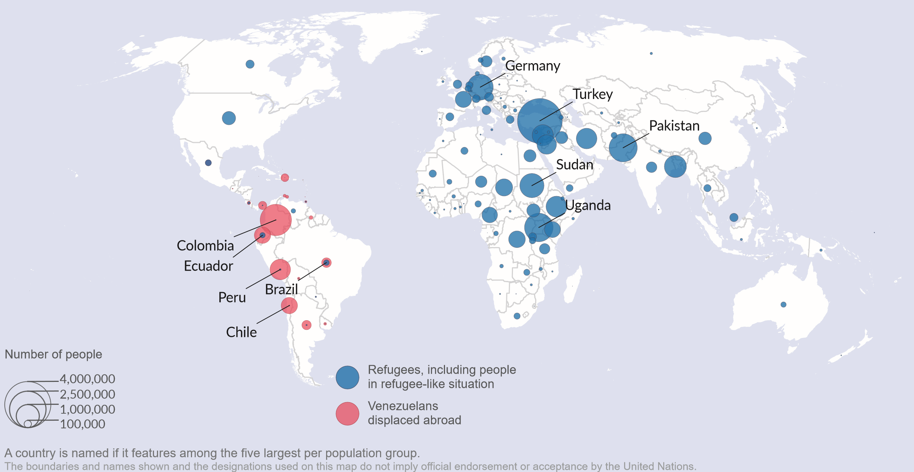
The number of refugees has doubled in the last ten years to reach 21.3 million
Key changes within the year include:
Sharp growth in VDA primarily in Peru, Colombia and Ecuador as COVID-19-related travel restrictions eased in the region.
As conflicts persist or worsened, the large refugee populations from Syria, Afghanistan, South Sudan, the central African Republic and Myanmar saw further increases in the year
Refugee populations in Turkey, Uganda grew by more than 100,000, while the population in Chad saw an increase of more than 75,000
Source: 2021 Global Trends, © UNHCR
Notes:
Refugees

Slide 8
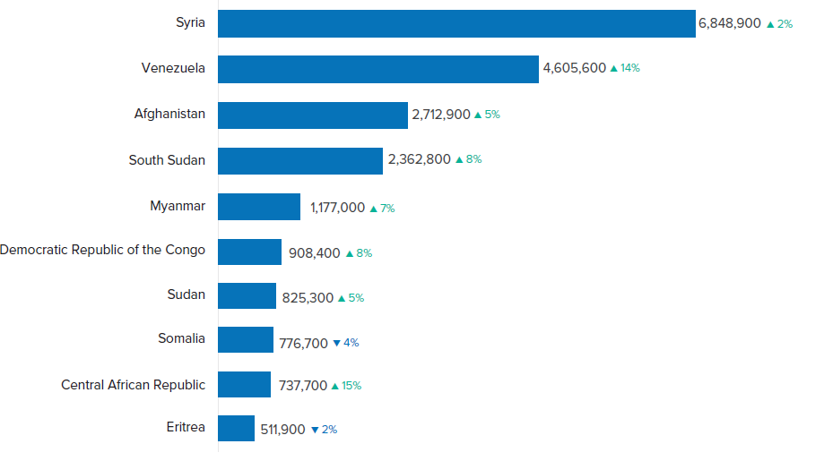
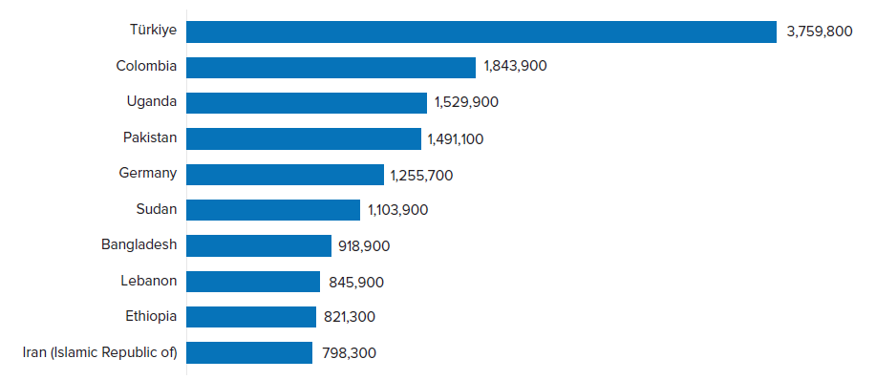
83 per cent are hosted by low- and middle-income countries. 72 per cent are in neighbouring countries.
Syria and Venezuela are the largest countries of origin for people displaced across borders.
Türkiye (15 per cent of global total), Colombia and Uganda remained the three largest hosting countries.
Source: 2021 Global Trends, © UNHCR
Source: 2021 Global Trends, © UNHCR
Note – as of May 2022: Ukraine 4.9 million

Slide 9
Internally Displaced Persons

Slide 10
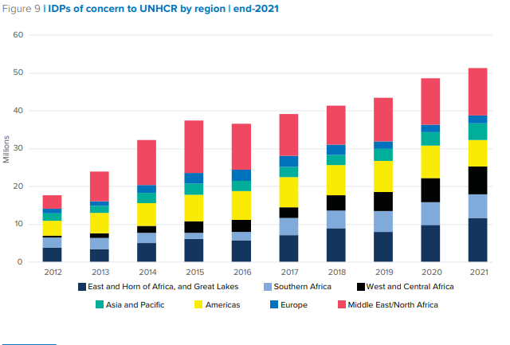
IDPs account for more than 60 per cent of all forcibly displaced people worldwide
Throughout the year, there were 9.3 million new internal displacements due to conflicts in the 35 countries where UNHCR is operationally active. 5.3 million IDPs returned during the year.
There were an additional 23.7 million internal displacements in 2021 in the context of disasters and due to the impacts of climate change during the year, most of whom returned. ¹
Source: 2021 Global Trends, © UNHCR
¹ Internal Displacement Monitoring Centre

Slide 11
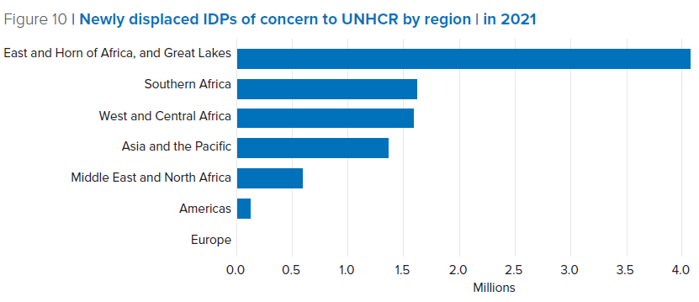
Almost all regions globally witnessed large new internal displacements in 2021
More than three-quarters of all new internal displacements in 2021 occurred in Sub-Saharan Africa.
The largest new displacements occurred in Ethiopia (2.5 million), the Democratic Republic of Congo (1.5 million), Somalia (544,000), Sudan (543,000), South Sudan (529,000), Burkina Faso (508,000) and Nigeria (500,000) throughout the year.
In other regions, 1.2 million new displacements stemming from humanitarian crisis in Afghanistan (777,400) and Myanmar (433,000). Many Afghans returned during the year (791,000).
Source: 2021 Global Trends, © UNHCR
Notes:
New displacement as discussion
One line about largest IDP populations, including reference to UKR (7 million)

Slide 12
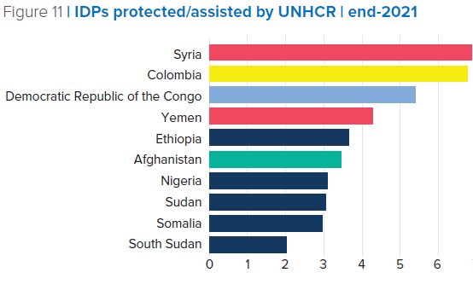
At least 5 million more people remain internally displaced at the end of 2021, compared to the previous year
The IDP population increased in nine out of ten countries that already had the largest IDP populations.
In Colombia, further to a revision of IDP figures in consultation with the Government, 6.8 million IDPs were still in need of humanitarian assistance and solutions at the end of the year.
At end-May 2022, more than 7.1 million IDPs remained displaced in Ukraine.
Source: 2021 Global Trends, © UNHCR

Slide 13
Asylum Seekers

Slide 14
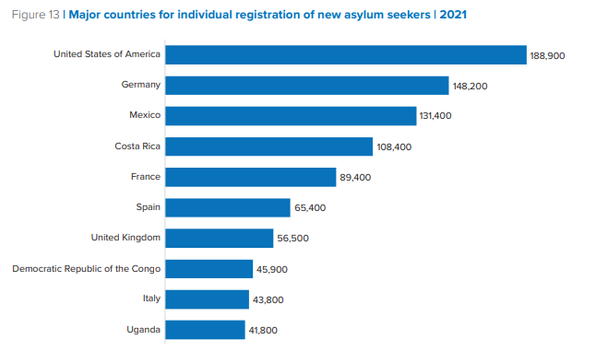
In 2021, States and UNHCR collectively registered some 1.7 million individual asylum applications in 155 countries
35% increase compared to 2020 yet remains below pre-COVID-19 level.
1.4 million new individual asylum applications, 66% received in just ten countries.
Large increases in asylum applications in Germany, Mexico, the Democratic Republic of the Congo and Costa Rica, but also significant decreases in Brazil, Peru, Spain and the United States of America.
Major source countries were Afghanistan (+49,300 to 125,600), Nicaragua (+92,700 to 111,600) and Syria (+37,600 to 110,000).
Source: 2021 Global Trends, © UNHCR
Notes:
ASYLUM TRENDS

Slide 15
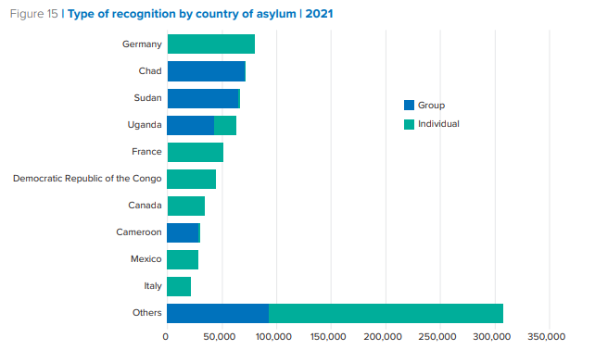
794,100 people received protective status
494,900 received individual refugee or other protection status and 299,200 people received international protection through group procedures.
The Total Protection rate stood at 49% consistent with previous years.
4.6 million pending asylum seekers at the end-year. There were significant reductions in Canada, Ecuador, France and Greece, but increases in 95 countries, notably in Mexico, Costa Rica and the United States.
519,200 individual asylum applications were rejected.
Source: 2021 Global Trends, © UNHCR

Slide 16
Solutions

Slide 17
The availability of durable solutions to refugees improved compared to 2020. It remains however just a small fraction of the global needs
Refugee Returns
Voluntary repatriation returned to pre-COVID-19 levels, reaching 429,300. The majority of refugee returns were to South Sudan (270,200), Burundi (40,900) and Syria (36,500).
Resettlement
57,500 refugees were resettled in 2021, remaining almost 50% below 2019 levels and accounting for just 4 per cent of the global resettlement needs.
Naturalization
In 2021, an estimated 56,700 refugees from 161 different countries of origin naturalized in 23 host countries, a two-thirds increase compared to 2020. 89 per cent of all reported naturalizations occurred in European countries.

Slide 18
Stateless people

Slide 19
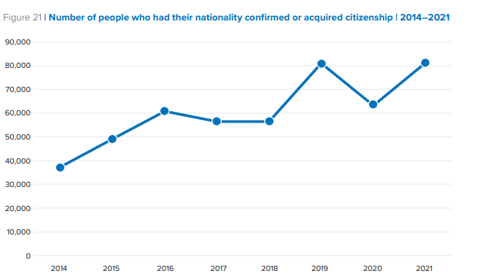
Progress was made on improving data on stateless populations and supporting the acquisition of citizenship
Increase in number of known stateless people to 4.3 million, driven by 1) additional countries reporting stateless populations for the first time, 2) improved registration and coverage, 3) children being born into statelessness.
Record number of stateless people acquired citizenship (81,200). Since the start of the #IBelong Campaign in 2014, 485,400 people have acquired a nationality or had their nationality confirmed.
Source: 2021 Global Trends, © UNHCR

Slide 20
Global Trends 2021
For additional information, including access to the full datasets please see the complete report and the refugee data finder:
www.unhcr.org/globaltrends
www.unhcr.org/refugee-statistics/
Notes:
45 minutes

